Slide 1
Strategy Update

Slide 2
Our members say continue to…
Add More Vendor and Channel Members
Improve how Members Collaborate
Expand to provide Solution Support
TSANet has the Relationships, Tools and Processes needed to enable Multi Vendor Support

Slide 3
Strategy Roadmap – High Level
2017
2018
2019
Membership & Marketing
Add more Technology and Channel Partner programs
Create new brochure and banner for Solution Support
Improve Member adoption
Offering & Operations
Continue to Deploy Case Exchange and improve based on Member feedback
Work with Vendors to pilot next generation solution support
Pilot next generation collaboration platform
Membership & Marketing
Add more Technology and Channel Partner programs
Add more Channel Members
Improve Member adoption
Public Website refresh
Offering & Operations
Membership & Marketing
Add Solution Support programs (Vendor and Channel mix)
Add more Channel Members
Improve Member adoption of solution support offering
Offering & Operations
Create and deploy next generation collaboration platform
Create and deploy Solution Support Framework

Slide 4
2018 Plans
1H 2018
2H 2018
*Membership
Add more Partner Programs
Expand Focus Groups
*Marketing
Public Web Refresh
New Member Help
New Brochures
Services
Define long term Case Exchange Roadmap
Define scope of Web Release
Membership
Add more Partner Programs
Marketing
TSW Vegas
*Services
Develop new Member web with integrated Case Exchange
Define detailed 2019 roadmap for Case Exchange

Slide 5
Membership Status
Add more Members…
Member growth driven by new Partner groups (570+)
Grow open group Members to 102 by end of year (98 now)
Expand Focus Groups…
Europe, India, Australia and North America groups now in place (Will add Japan in 2019)
Face-to-face meetings twice a year
Add more Partner Groups…
Two new Partner Groups in 2018 and many more in the pipeline
574 Members

Slide 6
Marketing Status
Create and launch new Public Web
Completed. (Show)
Update Brochures and Master Slides
Completed. (Show)
Create new Member Help
Completed. (Show)
Promote 25 Year Anniversary
In process. Web, Blogs, TSW Vegas..
TSANet.org

Slide 7
Services Status – Technology Committee
Create Team
Symantec, Cisco, Microsoft, Red Hat, IBM, Dell EMC, VMware, NetApp
Create long term Case Exchange Roadmap
Completed. Case Exchange Lite
Set requirements for Dec 2018 Member Web
Completed. See Next Slides
Set Data Protection requirements
Completed. Case Exchange Lite meets requirements

Slide 8
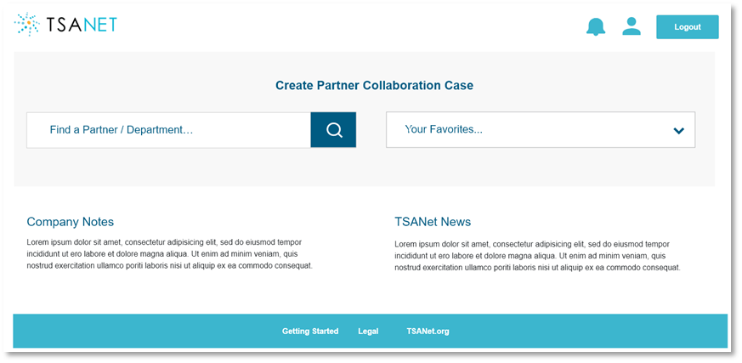
Services Status – New Member Web
Develop Prototype for review
Completed. (Show)
New API first architecture
Development started
New simplified caller UI
Development will start in September
Case Exchange Lite
Will be the new default contact method
Development will start in September

Slide 9
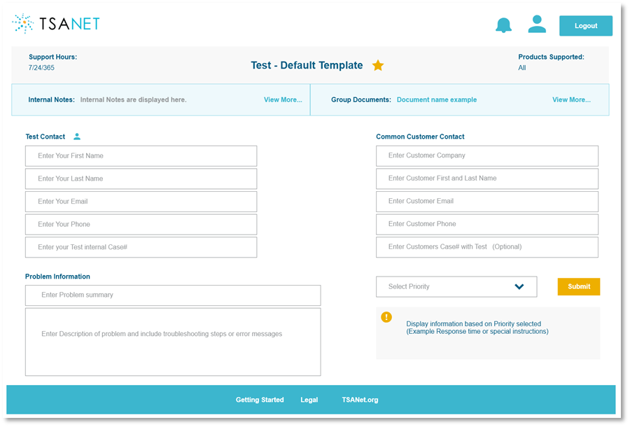
Services Status – Case Exchange Lite
Develop Prototype for review
Completed. (Show)
Develop as part of new Member Web
Development will start in September
Beta solution
Beta will start in October. Will have Webinar Oct 24th at 10:00am CST
Go Live in Phases
First Members will go live by end of year. Remaining will migrate in 2019

Slide 10
TSANet Case Exchange Light process overview
New
@
@
Find Member
1
NEW Case Email or Member API interface
Complete Form
2
2
@
Member (Sender)
Member (Receiver)
Initial Response weblink or Member API message
Response
3
@
Work the case – Email or Secure Team Site
Feedback
4
@

Slide 11
Questions?
paul@tsanet.org or dennis@tsanet.org

