Slide 1
Introduction to TSANet

Slide 2
What is TSANet…
TSANet is a global collaborative alliance consisting of hundreds of companies working together to improve their shared customers’ support experiences.

Slide 3
TSANet Provides
A proven Not-For-Profit Vendor Neutral Organization focused on Multi Vendor Support
A Legal and Operational infrastructure to solve support problems faster
A Tactical user interface to collaborate with a member or members
“TSANET IS THE SMART SOLUTION FOR INDUSTRY MULTI VENDOR SUPPORT”
Armando Calderon
IBM Corp

Slide 4
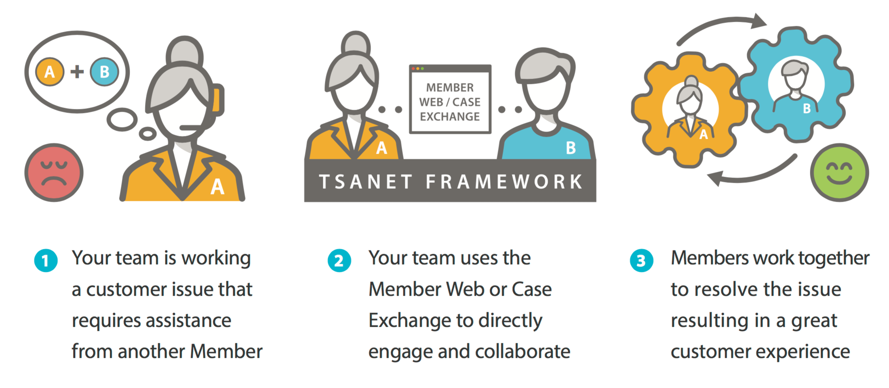
How does it work…
Your team uses TSANet Connect to directly engage and collaborate

Slide 5
Membership Relationship Structure
Open Groups
Partner Program Groups
Many to Many (Open Groups Basic/Premium)
Members within the group can collaborate with all other members
Basic: Next Business Day, Premium: 24/7/365
Mutual Customer is required
Basic or Premium members can create Partner Groups
Groups can be Many-Many, One-Many or One-One
Host Member(s) customize the requirements
Invite existing members or new Limited members
Mutual Customer
Premium Members
Basic Members

Slide 6
Overview of TSANet Connect Process
Find Member
1
NEW Case Email or Member API interface
Complete Form
2
2
Member (Sender)
Member (Receiver)
Initial Response weblink or Member API message
3
Work the case – Email, Phone or Secure Team Site

Slide 7
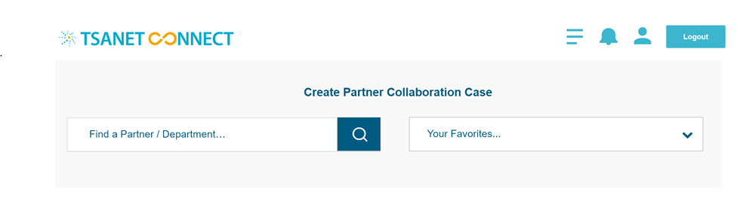
Sender Experience – How to use – Find a Member...
Type in the name of the company or department. This is a dynamic search
Use the pulldown to view and select from your favorites. Easily add favorites by selecting on a process form

Slide 8
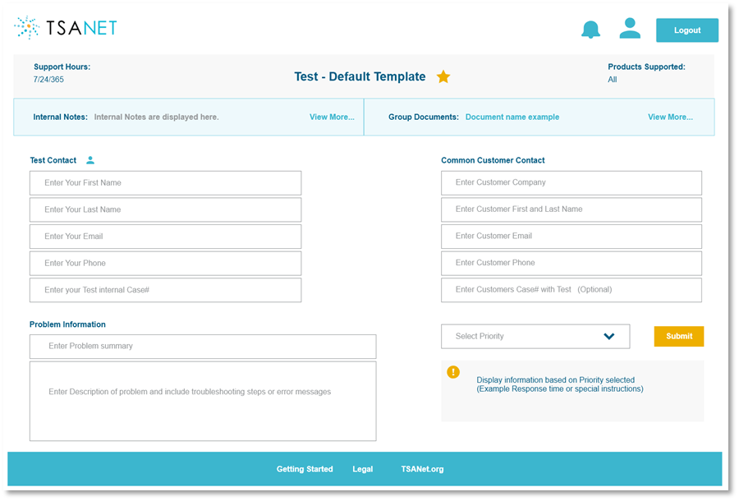
Sender Experience Create a Collaboration Case…

Slide 9
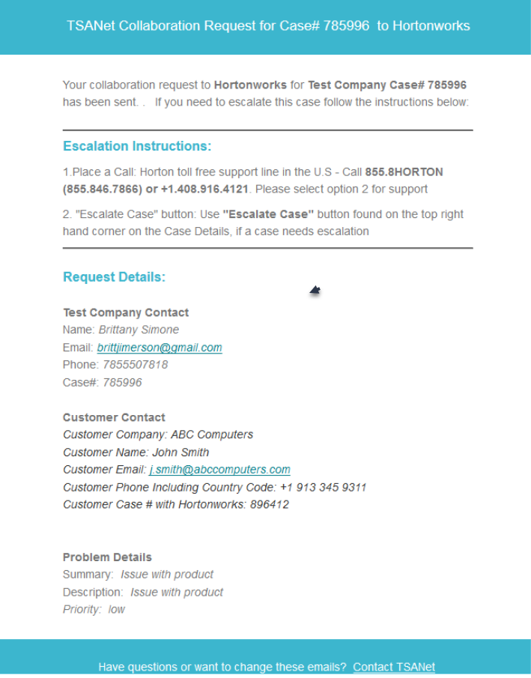
Sender Experience (email received after placing a call)

Slide 10
Receiver Experience (email received from another member)

Slide 11
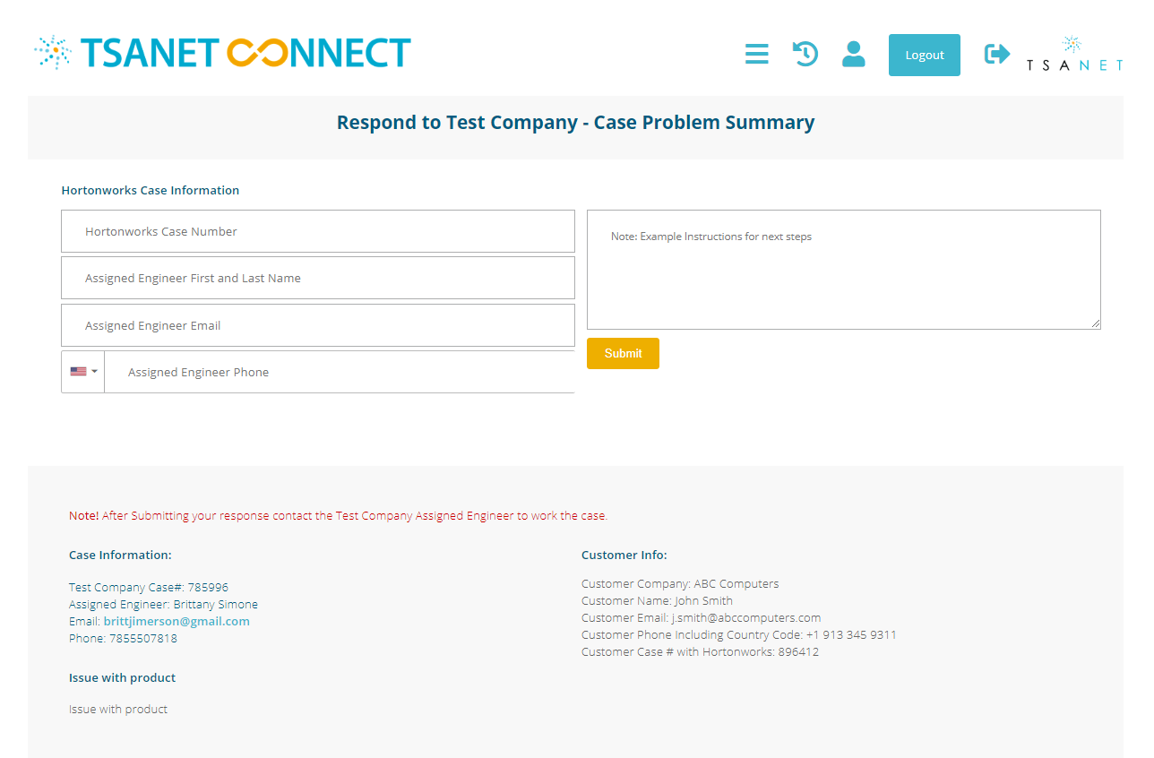
Receiver Experience (Form to acknowledge case)

Slide 12
Membership Options
Feature
Relationships With | All Premium and Basic Members | All Premium and Basic Members | Host Member
Ability to join Partner Programs | Included | Included | $500 per Program
Hours for Collaboration | 7/24/365 | Normal Business Hours | Defined by Host
SLAs for Collaboration | P1 = 2 hours, P2 = 4 hours, P3 = Next Business Day | P1 = Next business day, All others best effort | Defined by Host
TSANet Connect | Yes | Yes | Yes
Integrate your Systems | Yes | Yes | No
Create Partner Groups | Yes | Yes | No
Marketing | Listed on Homepage and Member page, Member Spotlight | Listed on Member Page, Member Spotlight | Listed on Member Page
Join Regional Groups or Committee | Yes | Yes | No
Board and Voting | Voting Member, Premium Global can join Board | Voting Member | No
Premium
Starting at $6,000
Basic
Starting at $3,000
Limited
$500 / Relationship

Slide 13
Webinar Series https://tsanet.org/tsanet-connect/

Slide 14
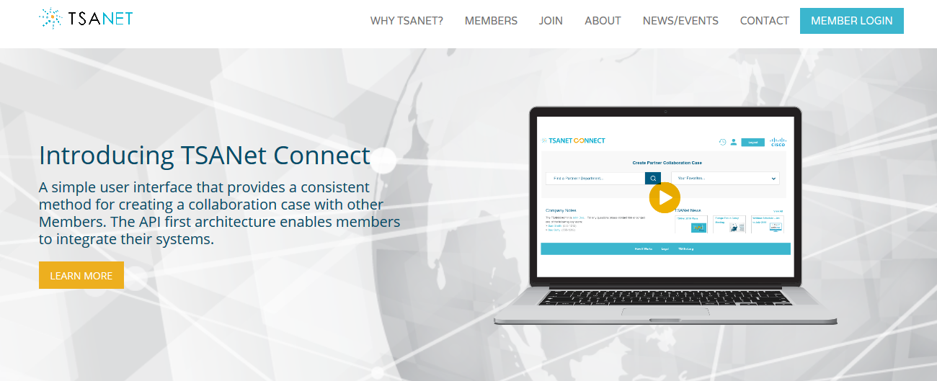
To Learn More…
TSANet.org
Membership@TSANet.org

